Slide 1
11/21 Agenda
Mapping Time
In a single static map
In a series of maps

Slide 2
Time in a single static map

Slide 3
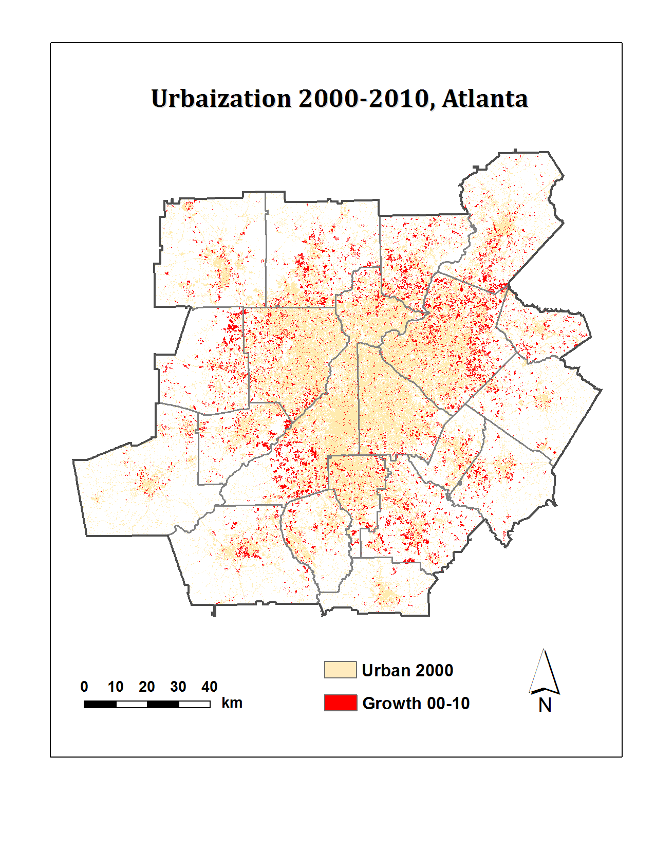
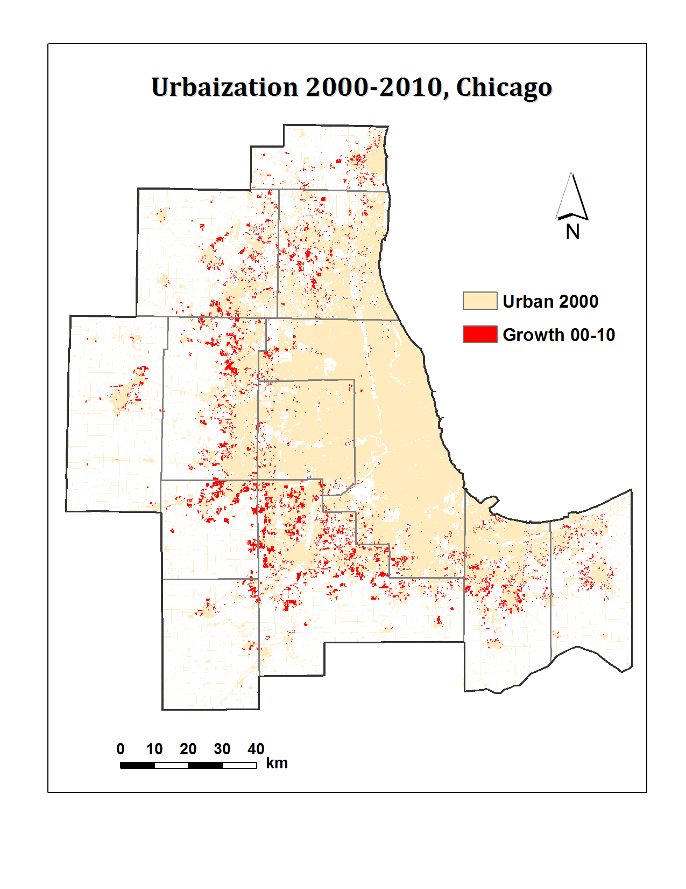
Urbanization Patterns
Atlanta
Chicago
Shading and coloring are useful for showing how areas change over time
Notes:
More in-fill development in Atlanta; more fragmented

Slide 4
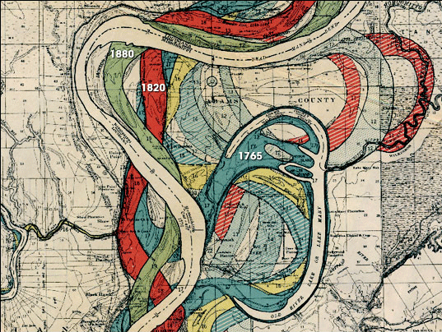
Ancient Course of the Mississippi Meander Belt
Use color coding to show the radically different flows of the river over time
U.S. Army Corps of Engineers, 1944
Notes:
How would you create an interactive/animated version of this map?

Slide 5
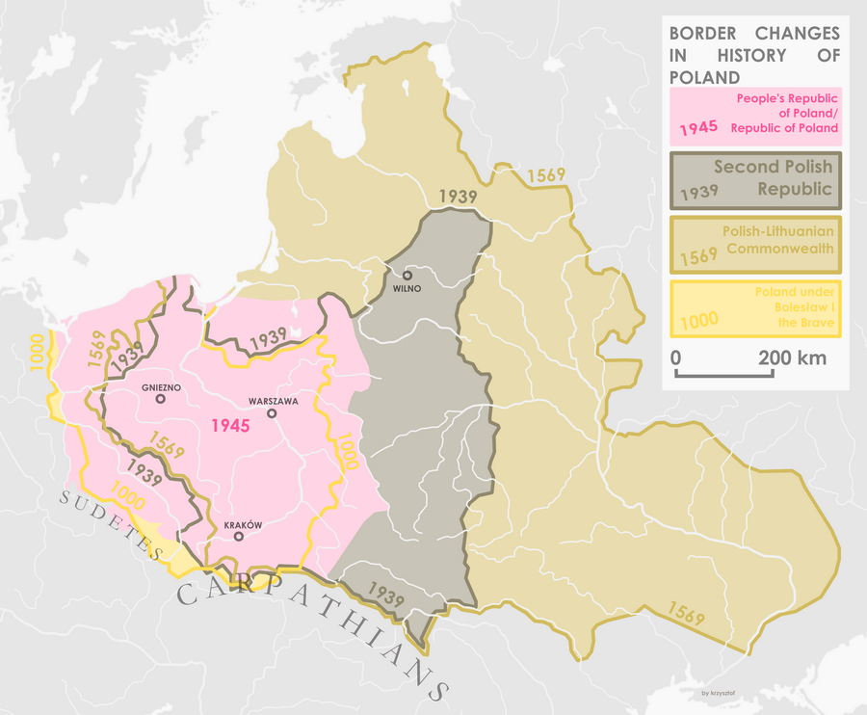
Use colors and symbols to show border changes over time

Slide 6
What symbolization can be used for representing time?
Shading and coloring
Labeling
Arrows
Line weights (solid vs. dotted lines)
A third dimension
… ...

Slide 7

Charles Minard's map of Napoleon's Russian campaign of 1812
Flow map
Notes:
An interactive version - http://www.masswerk.at/minard/

Slide 8
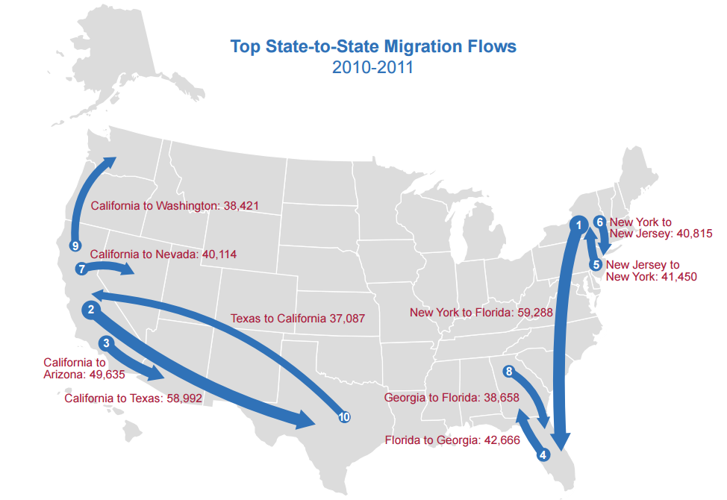
Flow map
U.S. Census Bureau, 2011 American Community Survey

Slide 9
Flow map
Show movements with lines, arrows, etc.
Thickness represents the volume of movement
Color may be used to show movement types
An animation flow map example

Slide 10
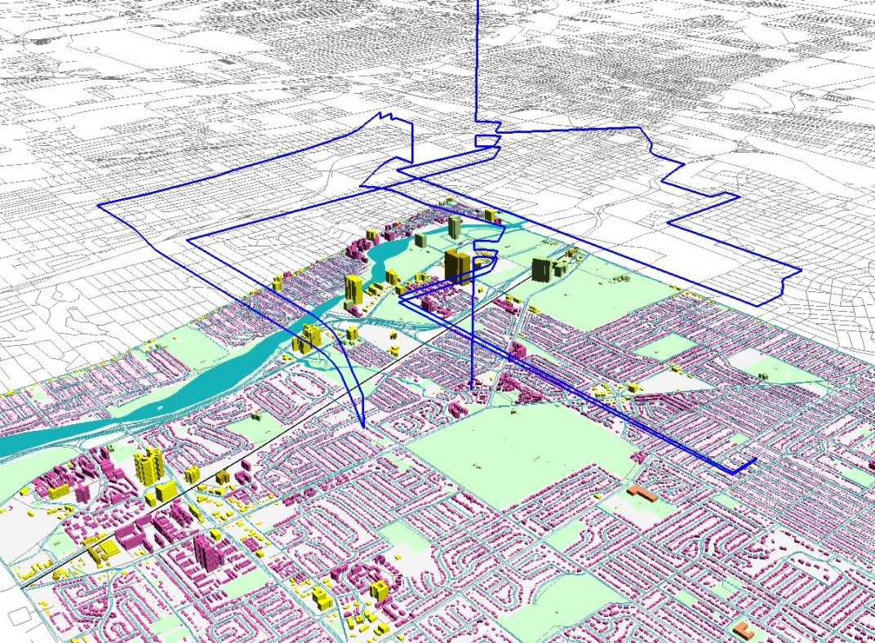
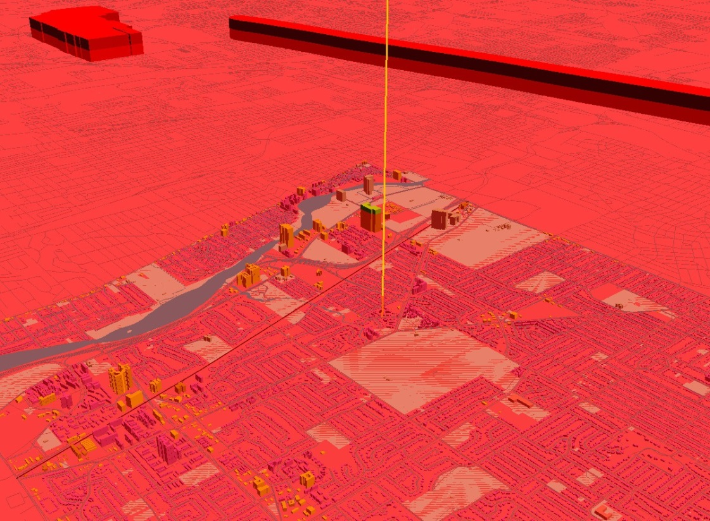
Post-September 11 experiences of the Muslim women in the USA
Nada’s life path on a typical weekday before September 11
Nada’s life path several days after September 11
Space-time cube
Mei-Po Kwan (2008)

Slide 11
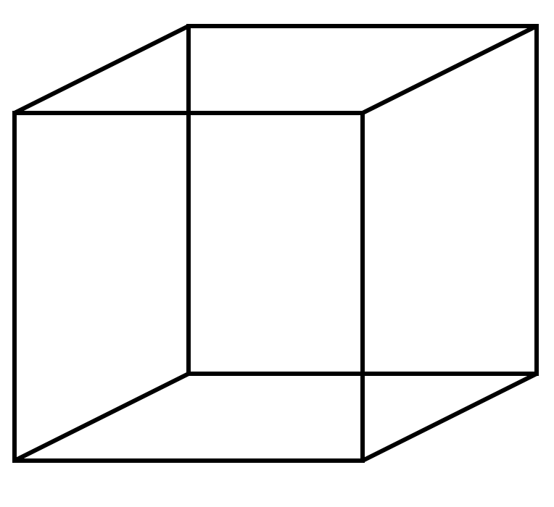
Space-time cube
Combines space and time in a cube
Horizontal plane: location in space
Vertical axis: time
time
latitude
longitude

Slide 12

Time in a series of maps
giphy.com

Slide 13
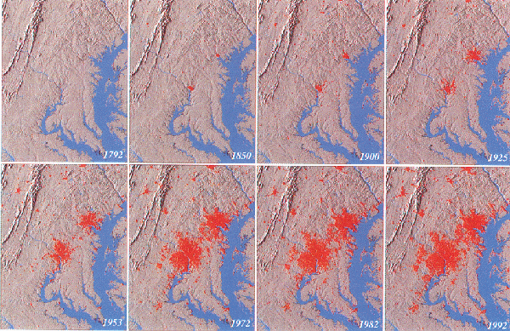
Two hundred years of urban growth for the Baltimore-Washington region
Notes:
http://landcover.usgs.gov/urban/data/bw_reg450.mpeg

Slide 14
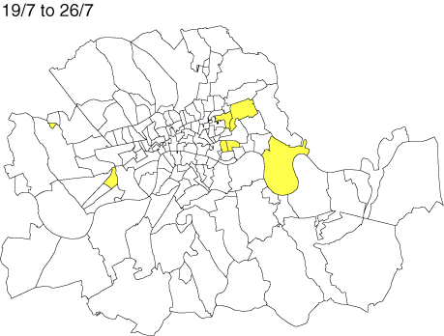

Cholera Outbreak in London, in 1866
Wikimedia Commons, 2005

Slide 15
Time series
Help deal with large amounts of data
“Constancy of the design allows the viewer to focus on changes in the data rather than on changes in the graphical design.” – Tufte, 1983

